Slide 1
Sierra Madre Middle School
“Home of the Hawks”
Notes:
1

Slide 2
People You Need To Know
Mr. Newsom, Principal
Mrs. Herrera, Assistant Principal
Ms. Klauschie, School Counselor
Mr. Lanagan, Instructional Coach
Ms. Pat, Secretary II

Slide 3
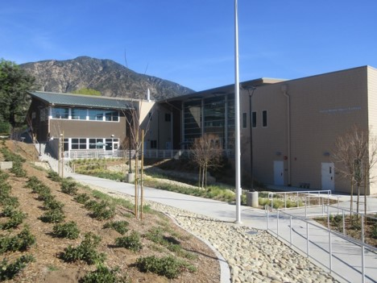
School Information
smms.pusd.us
Facebook
SMMS Students

Slide 4
“This Is Sierra Madre Middle School”
https://www.wevideo.com/view/1584044304

Slide 5
Core Values
Academic Achievement
Creative Culture
Safe & Nurturing Environment

Slide 6
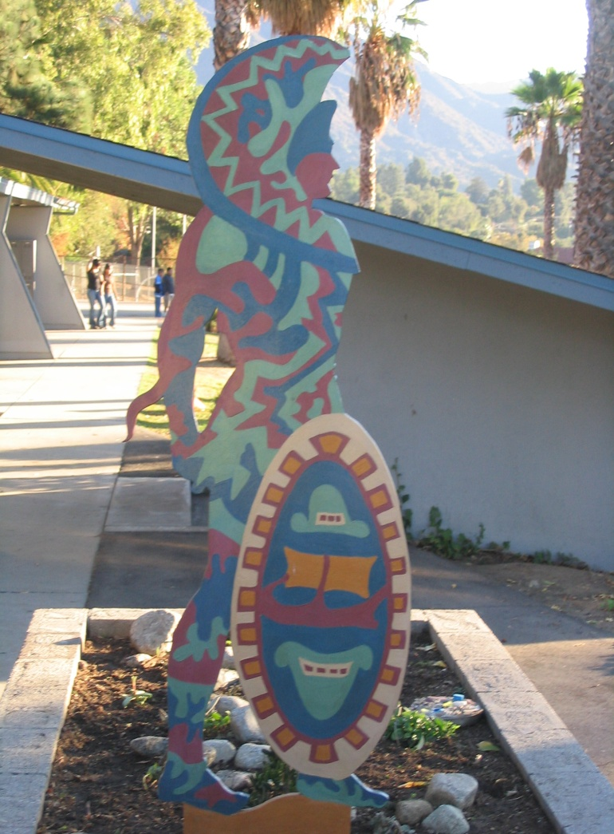
SMMS History
2004-05 Middle School Campus Was Established as part of a K8
2010-11 Construction Began on the New Middle School Campus
2012-13 SMMS Became a Stand-Alone Middle School
2014-15 The MDLIP Program Joined SMMS
2015-16 The New Campus Opened
2016-17 The Math Academy Joined SMMS
2018-19 SMMS Became the Largest
Stand-Alone Middle School in PUSD
2020-21 SMMS’ Attendance Zone Expanded
2021-22 The Class of 2024 Arrives!

Slide 7
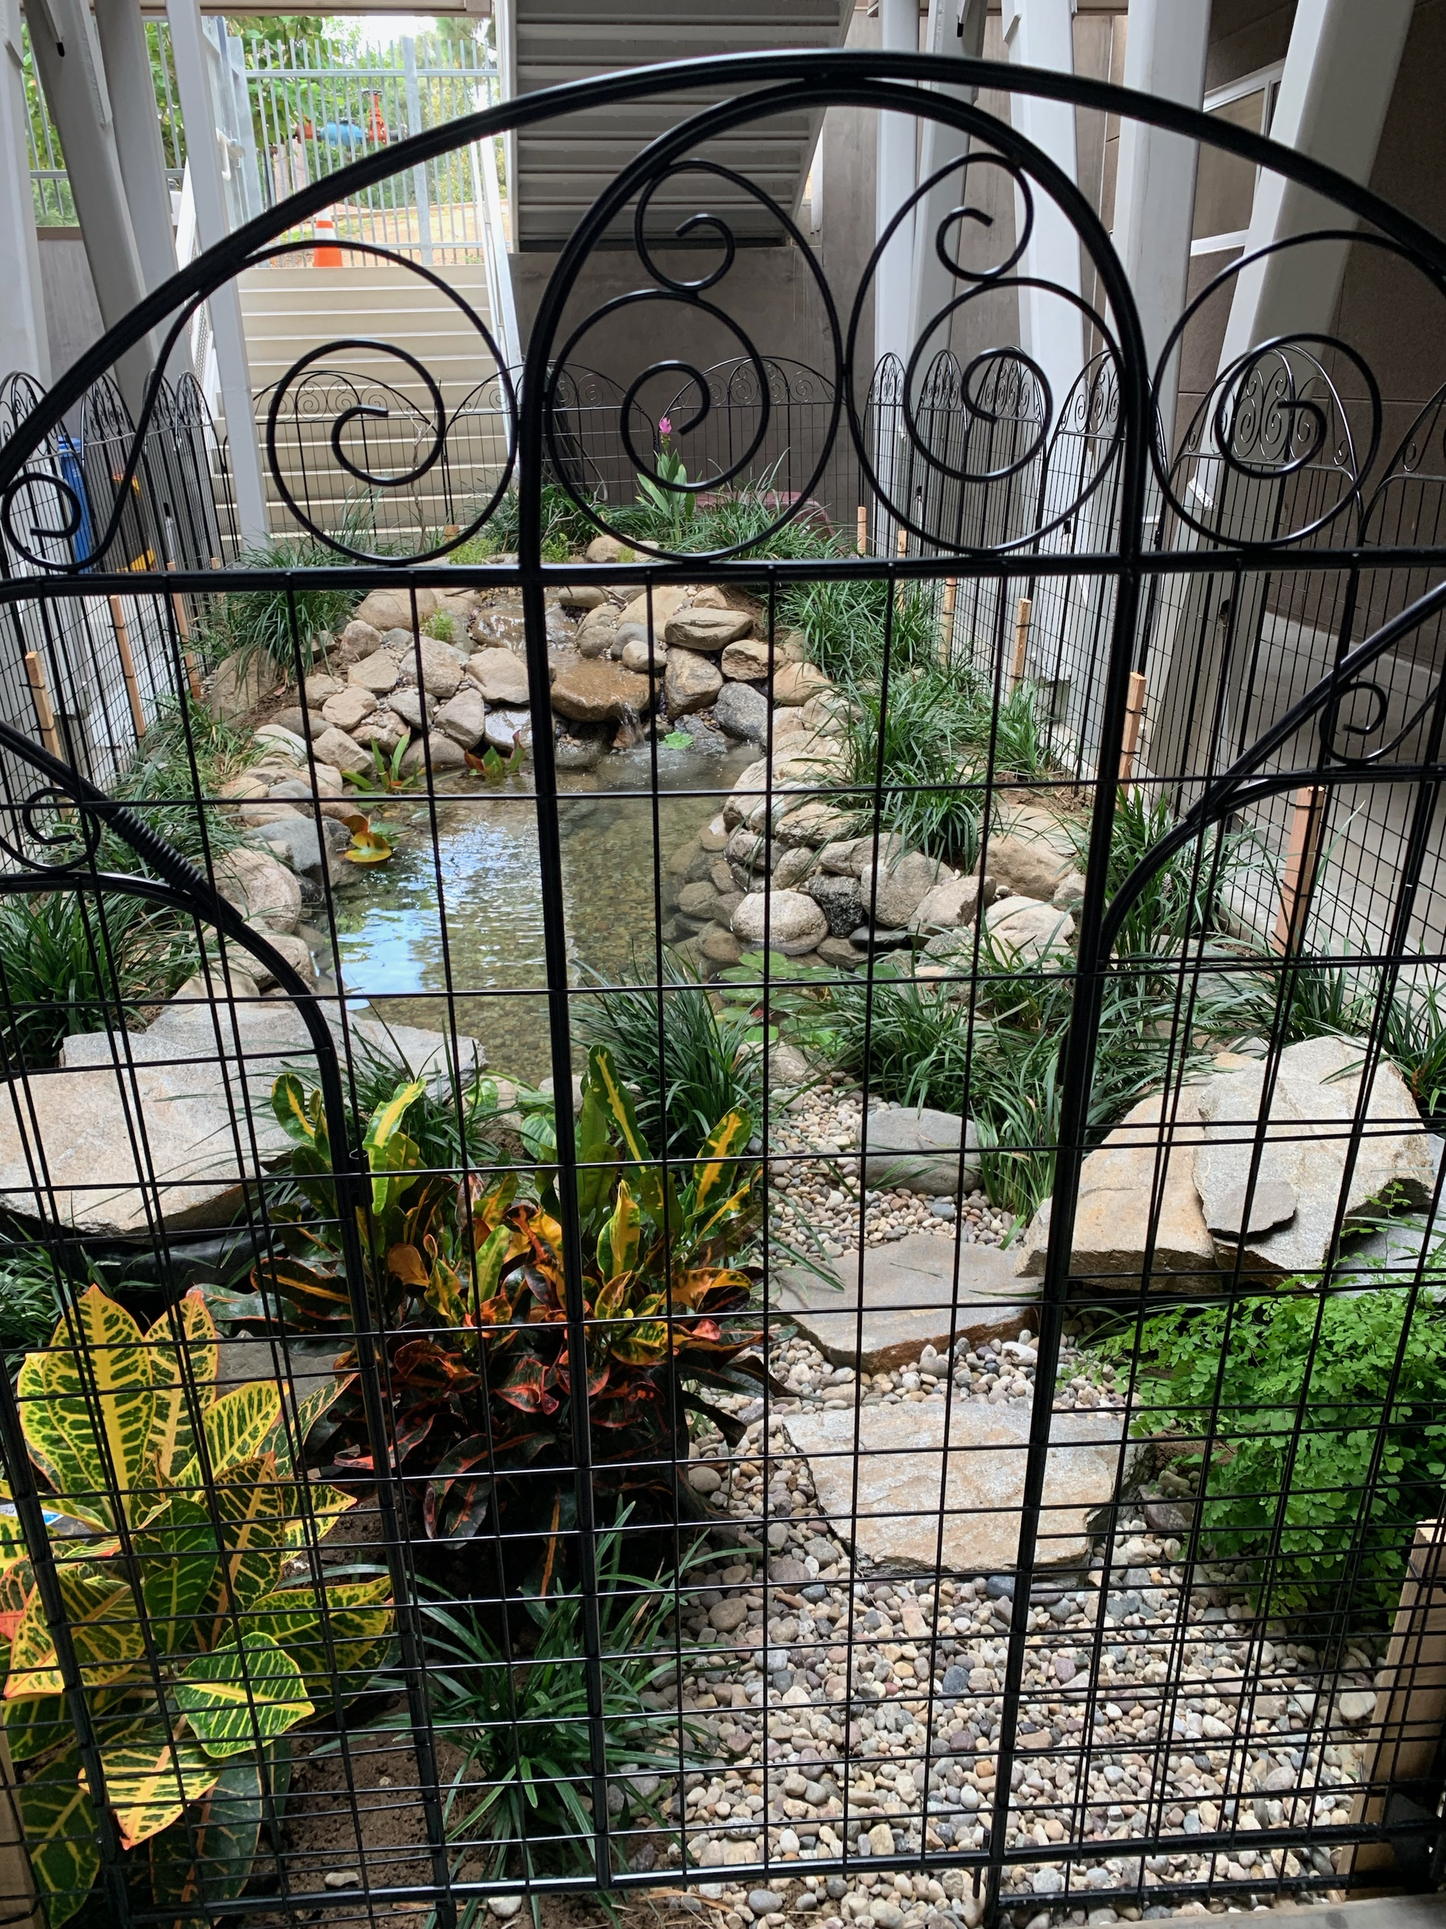
Facilities
20 Classrooms
Multipurpose Room
3 Science Labs
2 Visual Arts Labs
Ty Gaffney Gymnasium
Helen A. Pontarelli Library
Eco-Pond
School Garden

Slide 8
6th Grader’s Daily Schedule
Period 1 (60 minutes)
Period 2 (57 minutes)
Nutrition (15 minutes)
Period 3 (57 minutes)
Lunch (30 minutes)
Period 4 (57 minutes)
Period 5 (57 minutes)
Period 6 (57 minutes)
* Four-minute passing period between each period

Slide 9
Core Curriculum
English Language Arts
Mathematics
Science
History
Physical Education
Electives
Dual Language Immersion Program

Slide 10
Honors Math & Math Academy
Benchmark Math
Math 6, Math 7, Math 8
Honors Math
Math 6, Math 7, Math 8, Math I
Math Academy
Middle School & High School Math
AP Calculus Test in 8th Grade

Slide 11
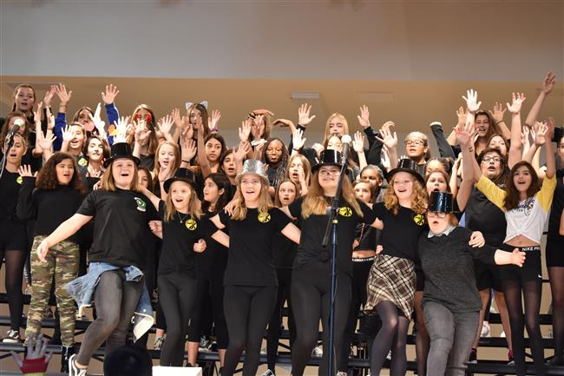
Electives
Visual Arts
PAK Song & Dance
Instrumental Music (iPAK)
Chinese Art & Culture
Chinese Poetry
Mandarin I
Technology
3D Printing
Hawk News
Creative Writing
History vs. Hollywood
Mandarin Language Arts
After School Enrichments (Drama, Instrumental & Robotics)

Slide 12
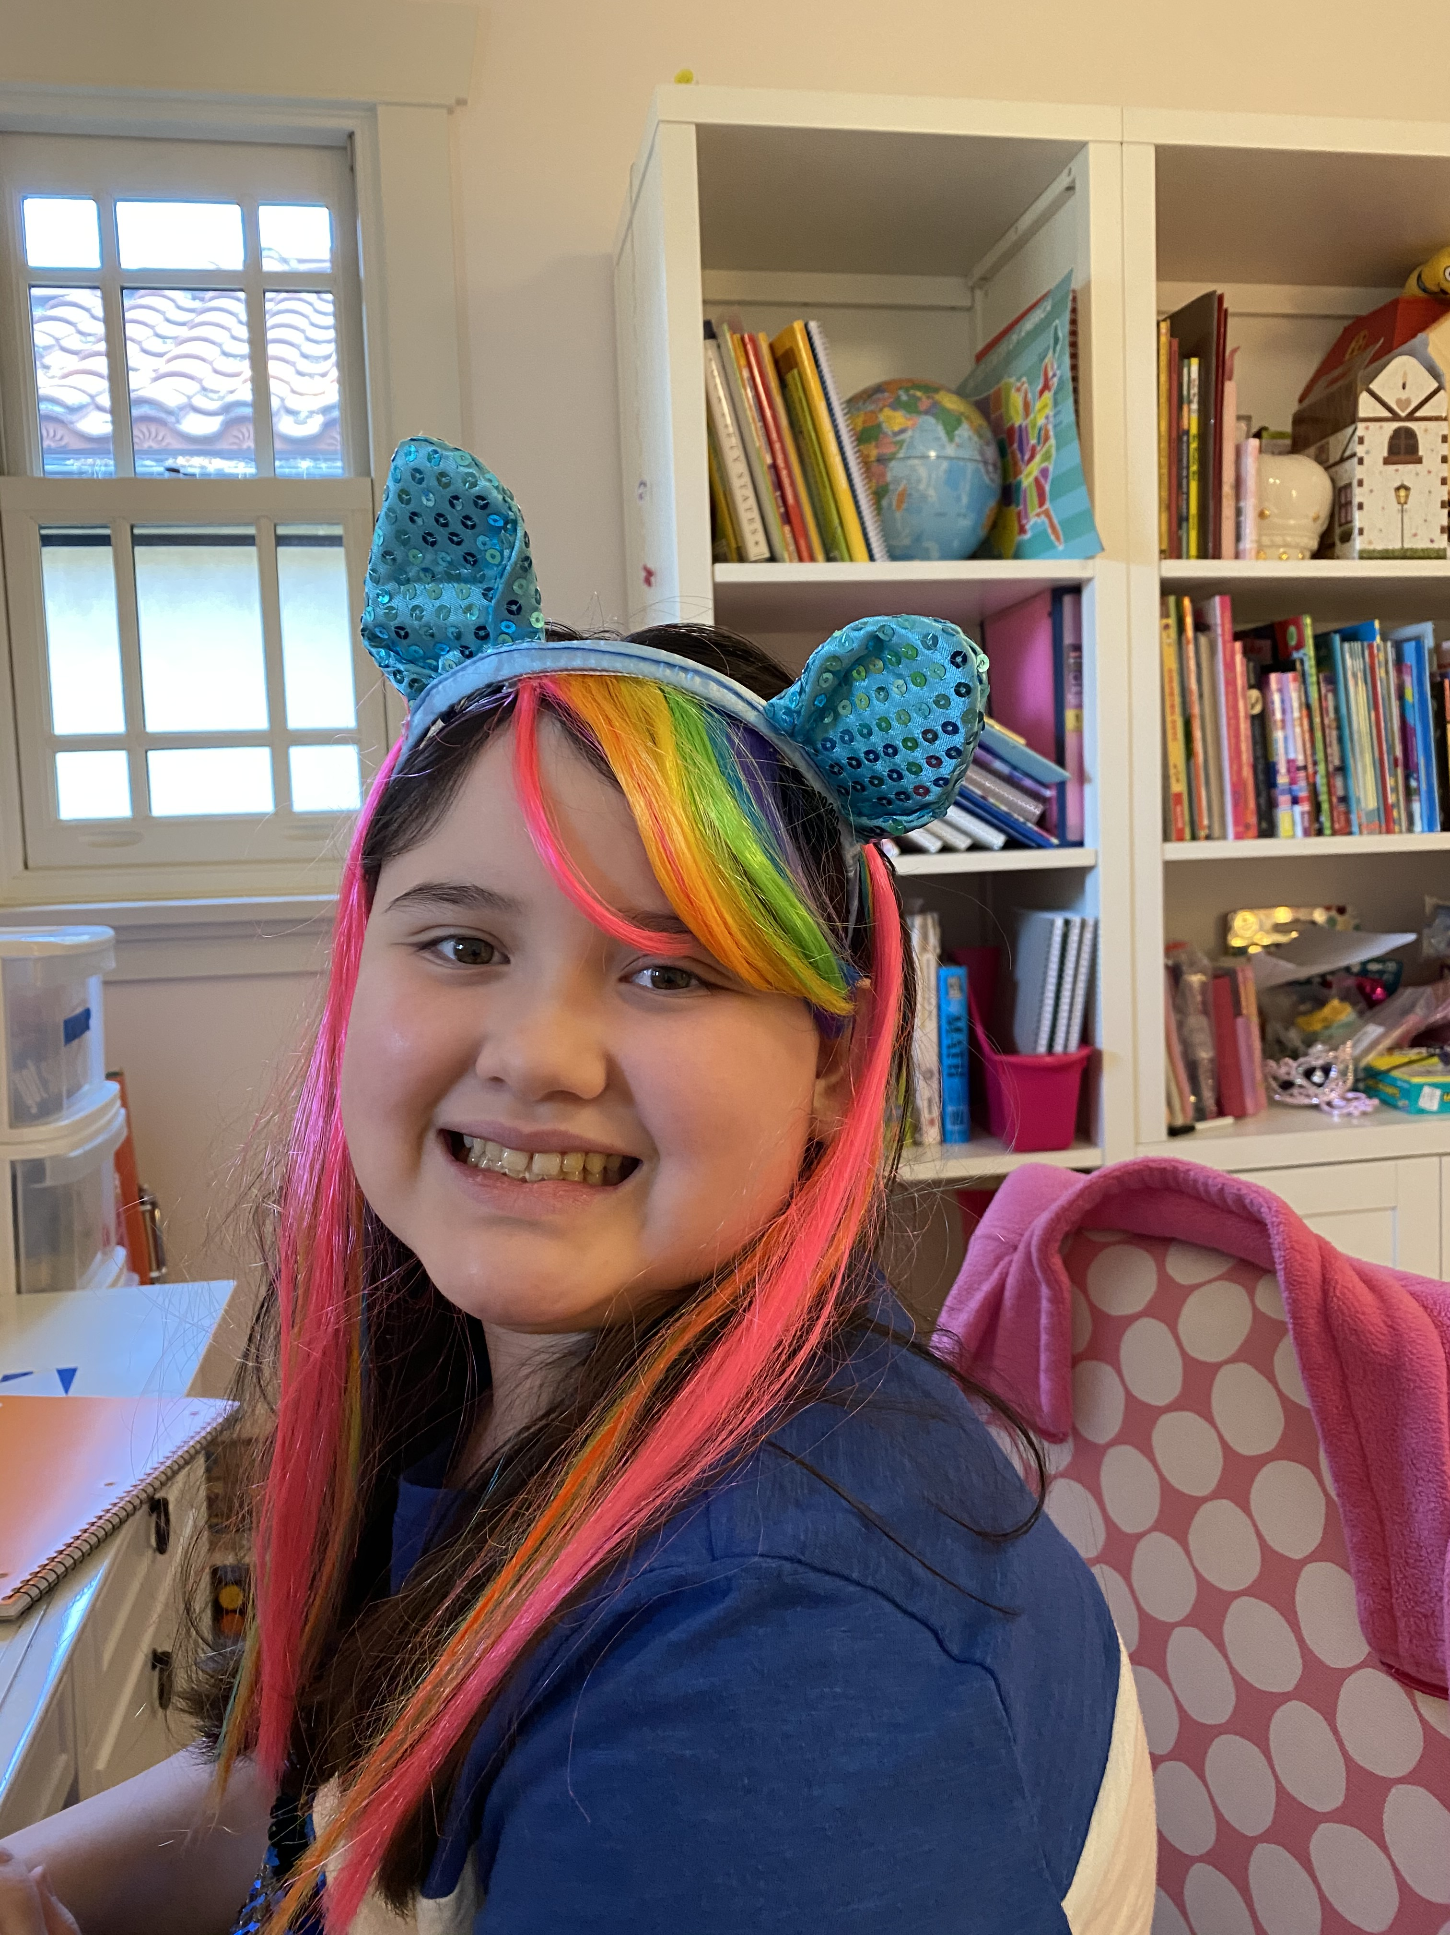
Extracurricular Activities
Student Council
African American History Bee
MLK Art & Essay Contest
Spelling Bee
Math Field Day
History Day
Science Olympiad
Mock Trial Club
Service Club
School Spirit Days
School Dances

Slide 13
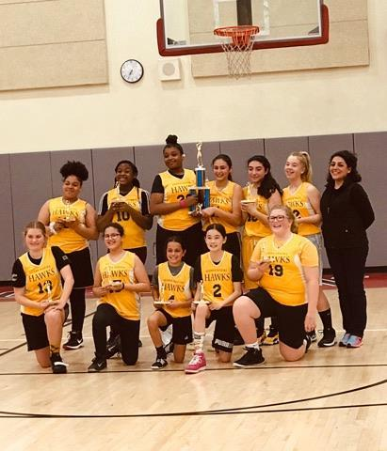
After School Sports Program
Cross-Country
Flag Football
Tennis
Girls’ Volleyball
Girls’ Basketball
Boys’ Basketball
Girls’ Soccer
Boys’ Soccer
Boys’ Volleyball

Slide 14
Break-Out Sessions
Notes:
14

